Slide 1
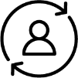
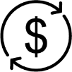
Key Partners
Key Activities
Value
Proposition
Customer/Client
Relationships
Customer/Client
Segments
Key Resources
Channels
/Delivery
Cost Structures
Revenue/Funding
Adapted from Tuulaniemi, J. (2010-2012). Service Design Toolkit | Process and templates, JAMK University of Applied Sciences, Creative Commons. https://creativecommons.org/licenses/by-sa/3.0/

