Slide 1
The SCARF Model
Learn design strategies and develop the skills and capabilities to help build internal capacity that enables innovation and brings new services to life.
QUTeX Service Excellence | Customer Centric Blueprinting
June 2021

Slide 2
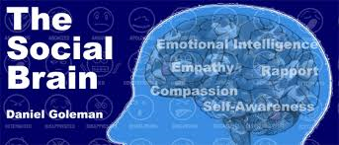
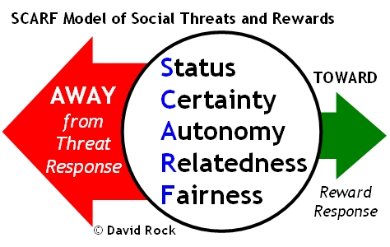
5 Domains of Human Social Experience and Response:

Slide 3
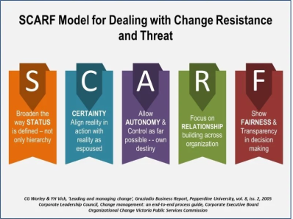
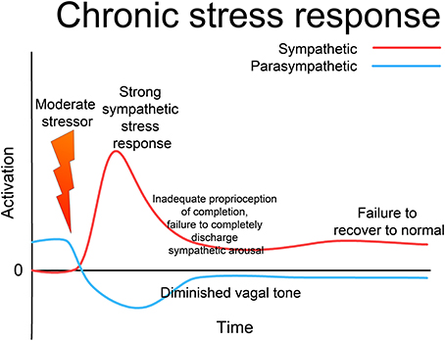
Status
When people realise that they might compare unfavourably to someone else, the threat response kicks in – releasing cortisol (similar to levels in extreme sleep deprivation and high levels of chronic anxiety).

Slide 4
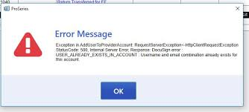
Certainty
Uncertainty registers in the brain (anterior cingulate cortex) as an error, gap or tension: something that must be corrected before they can move on. This can be profoundly debilitating because it requires extra neural energy – which diminishes memory, undermines performance and disengages people from the present.
Mild uncertainly attracts interest and attention

Slide 5
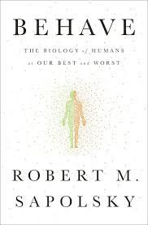
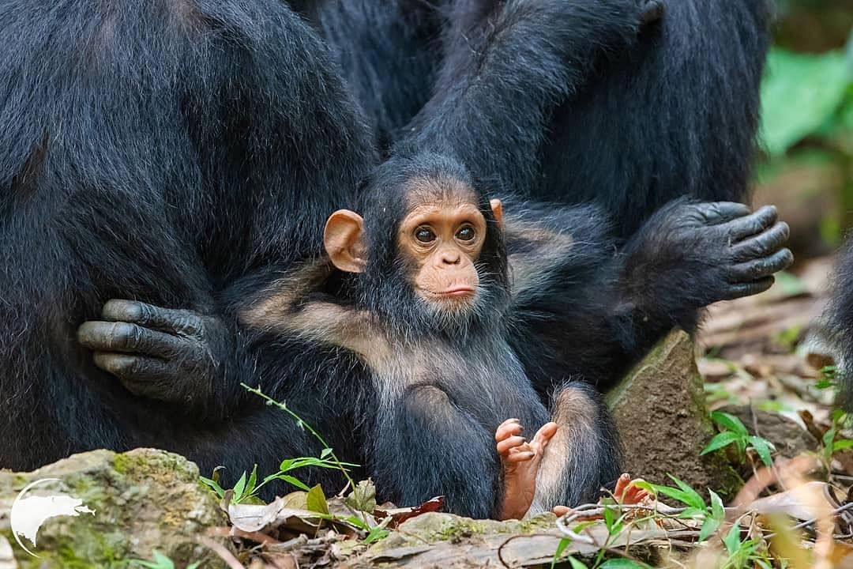
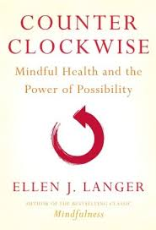
Autonomy/Control
Reduced autonomy generates a threat response (and perception of uncertainty is also aroused). By contrast, the perception of greater autonomy increases certainty and reduces stress.

Slide 6
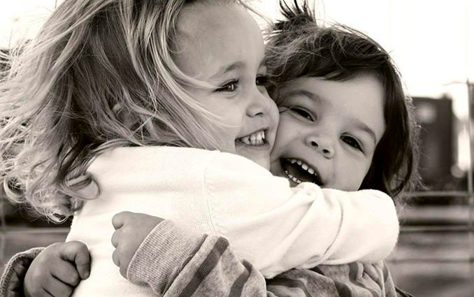
Relating to relatedness
In the brain, the ability to feel trust and empathy about others is shaped by whether they are perceived to be part of the same team/tribe.
The brain quickly makes friend or foe decisions.
Strong social connections secretes oxytocin (found in affection, maternal behaviour, generosity, authenticity, trust) disarms the threat response, opens neural connections – makes friends
Loneliness and isolation are profoundly stressful (perceived by the brain as physical hurt).

Slide 7
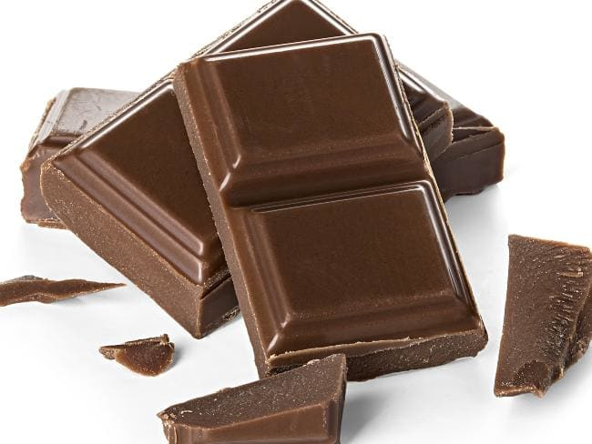
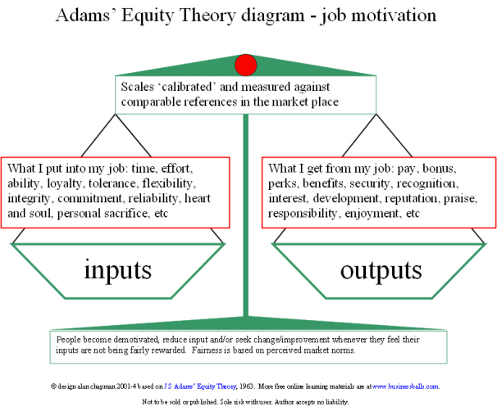
The importance of Fairness
Unfairness generates a strong response in the limbic system, stirring hostility and undermining trust.
As with status, people perceive fairness in relative terms –feeling more satisfied with a fair exchange that offers a minimal reward than an unfair exchange in which the reward is substantial.
Fairness produces reward responses in the brain similar to those that occur from eating chocolate.

Slide 8
SCARF Losses and Gains
 | Self: | Name: | Name: | Name:
STATUS
CERTAINTY
AUTONOMY
RELATEDNESS
FAIRNESS
OTHER
Considering the area of change. For each element, place an up arrow or down arrow in the box to identify the potential gain or loss for each person / stakeholder.
↓ = potential loss
↑ = potential gain
↔ = neutral or unsure
What insights does this give you about how to support you and your team through the change?
David Rock – SCARF model to consider ‘gains and losses’ during times of change
Notes:
Rock, D. (2008). SCARF: a brain-based model for collaborating with and influencing others. NeuroLeadership Journal, (1), 1-9.

Slide 9
SCARF Losses and Gains
 | Self: | Name: | Name: | Name:
STATUS
CERTAINTY
AUTONOMY
RELATEDNESS
FAIRNESS
OTHER
Considering the area of change. For each element, place an up arrow or down arrow in the box to identify the potential gain or loss for each person / stakeholder.
↓ = potential loss
↑ = potential gain
↔ = neutral or unsure
What insights does this give you about how to support you and your team through the change?
David Rock – SCARF model to consider ‘gains and losses’ during times of change
Adapted from: Rock, D. (2008) SCARF: A brain-based model for collaborating with an influencing others. Neuroleadership Journal 1: 1-9
Notes:
Rock, D. (2008). SCARF: a brain-based model for collaborating with and influencing others. NeuroLeadership Journal, (1), 1-9.

