Slide 1
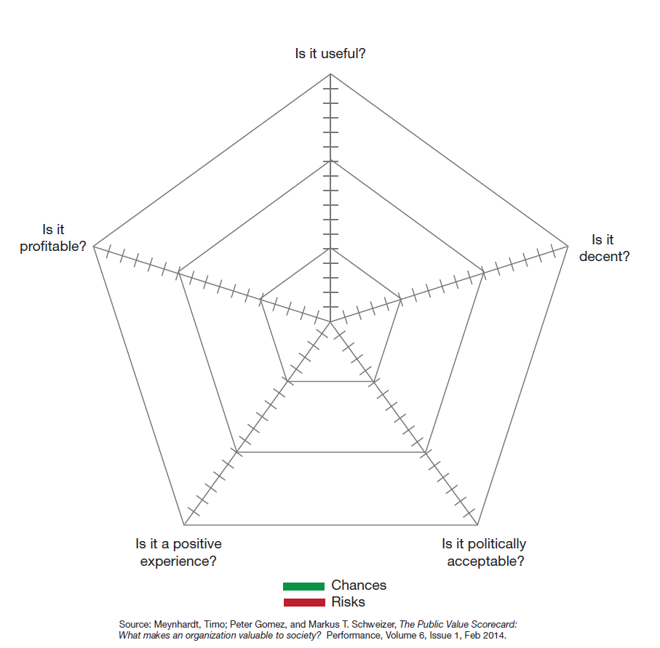
Public Value Scorecard
Notes:
Meynhardt, T., Gomez, P., & Schweizer, M.T. (2014). The Public Value Scorecard: What makes an organization valuable to society? Performance, 6(1), 1-8.

