Slide 1
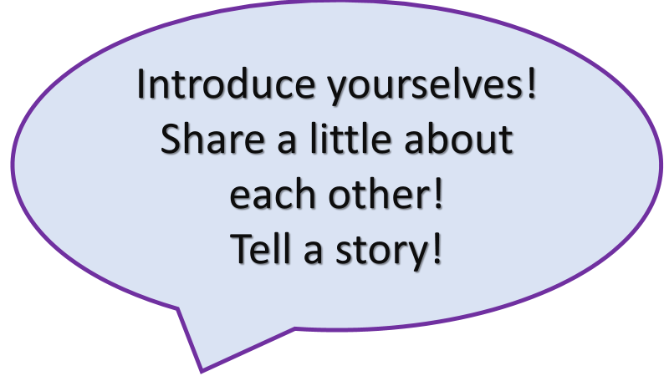
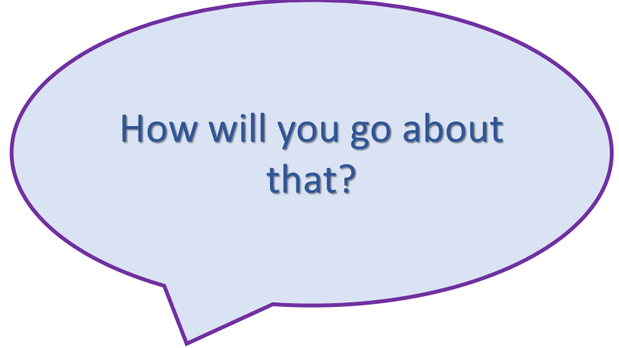
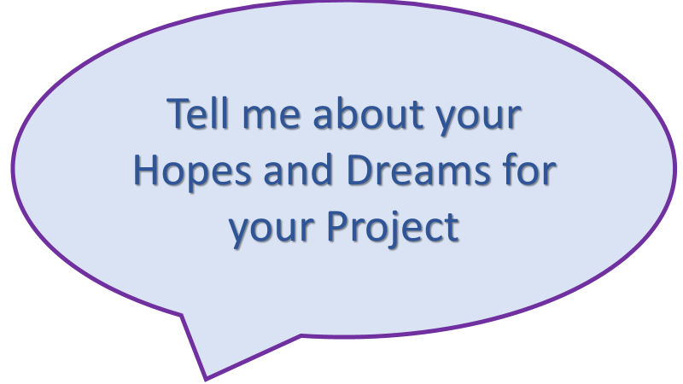
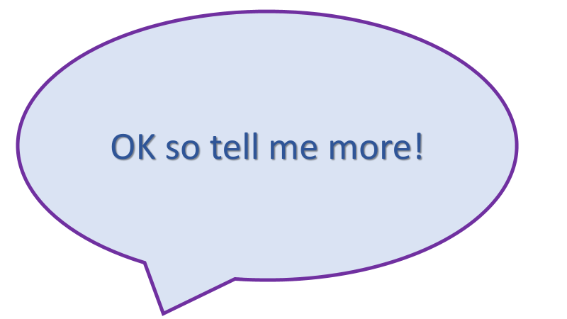
Peer to Peer Design Conversation Template
The proposed investigation into a challenge or an opportunity is:
The true value of the project is:
Key project milestones are:
The challenge or opportunity is:
The 5 bullet points of the outcomes are:
A 'map' of the project
The 3 most powerful project objectives are:
The 'tools' I propose to apply are:
How it will impact on operational effectiveness.
The possible challenges are:
What is in it for me?
My supervisor? My Business?

