Slide 1
QUT Library
Kelvin Grove

Slide 2
We welcome you!

Slide 3
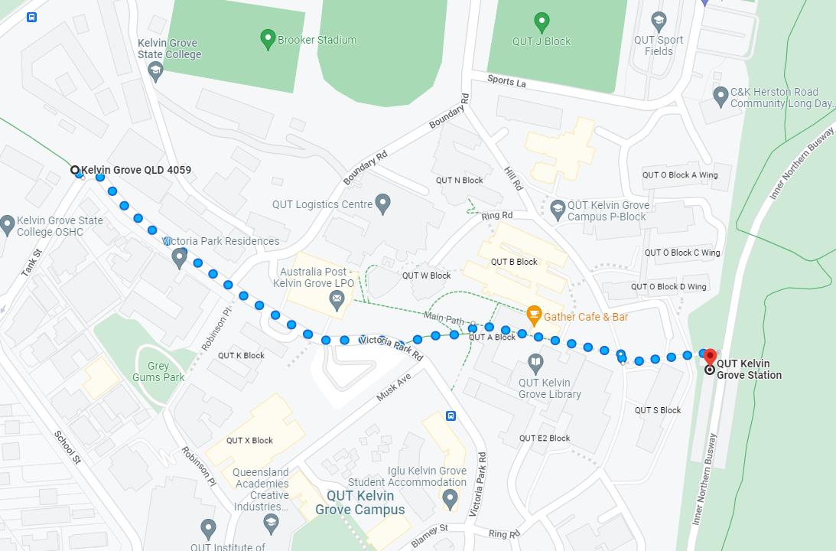
Where are we?

Slide 4
What can you do in the Library?
Do your own work and study
Read
Access QUT public wifi
Group work
Hangout… anything that doesn’t impact on other users

Slide 5
When are we open?
Monday to Friday: 7am - 8pm
Saturday & Sunday: 9am-5pm
24/7 for QUT students and staff

Slide 6
Borrow books (and more)
https://www.library.qut.edu.au/community/schools/students/

Slide 7
How to search… and get help!
www.library.qut.edu.au/community/

