Slide 1
Ways to Create and Communicate Value

Slide 2

The Why How What of your initiative
Why
How
What
Action
Developed from Sinek, Simon. Start with Why: How Great Leaders Inspire Others to Take Action. 2011. Penguin.

Slide 3
Ease of use grid
Difficult
Sweet Spot
High value, easy to implement
Estimated easer of implementation
Explore x N
Easy
Low
Estimated value of concept
High
Adapted from: Liedtka, J., & Ogilvie, T. (2019). The designing for growth field book: A step-by-step project guide. Columbia University Press. .
Notes:
Ambidexterity is thus critical to sustaining competitive advantage and to the organization’s enduring success.

Slide 4









The Value Proposition Concept
Gains describe the outcomes customers want to achieve or the concrete benefits they are seeking
Gain Creators describe how your products and services create customer gains
Customer Jobs describe what customers are trying to get done in their work and in their lives, as expressed in their own words
This is a list of all the Products and Services a value proposition is built around.
FIT
Pain relievers describe how your products and services alleviate customers pains.
You achieve FIT when your value map meets your customer profile – when your products and services produce pain relievers and gain creators that match one or more of the jobs, pains and gains that are important to your customers.
Pains describes bad outcomes, risks and obstacles related to customer jobs.

Slide 5









Strategy Business Model Canvas
Key Partners
Key Activities
Value
Proposition
Customer/Client
Relationships
Customer/Client
Segments
Key Resources
Channels
/Delivery
Cost Structures
Revenue/Funding
Adapted from Tuulaniemi, J. (2010-2012). Service Design Toolkit | Process and templates, JAMK University of Applied Sciences, Creative Commons. https://creativecommons.org/licenses/by-sa/3.0/

Slide 6
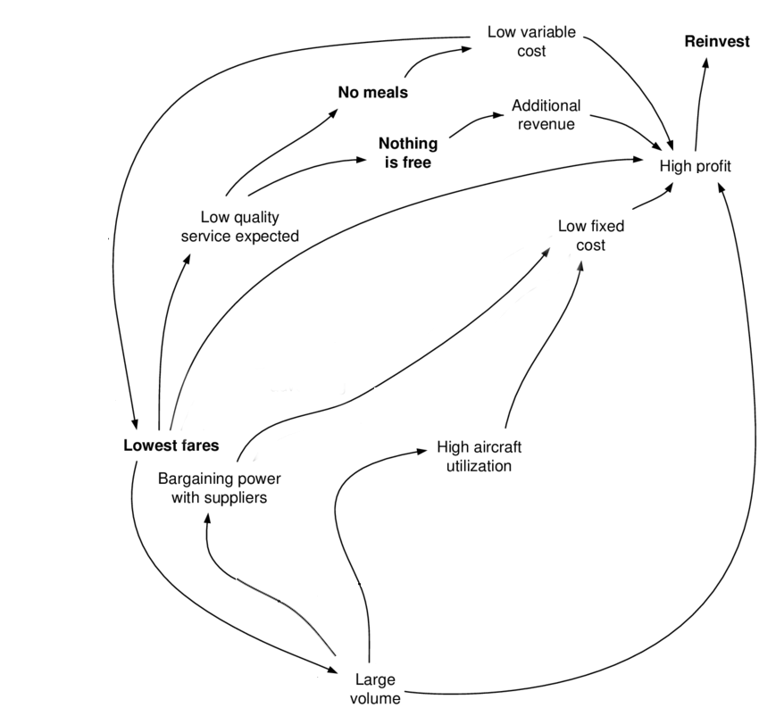
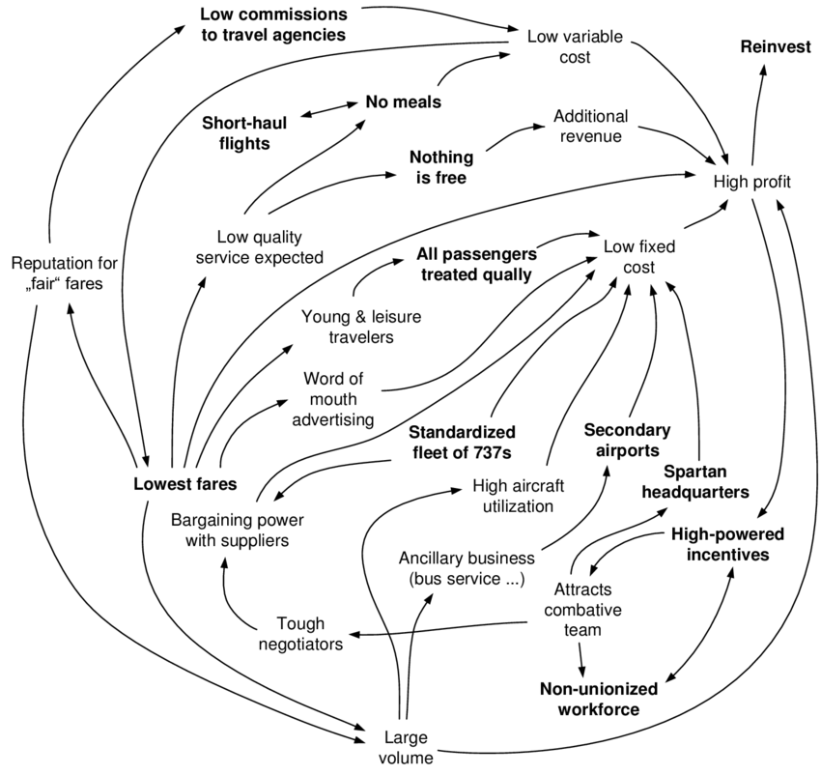
Business Models: The ‘Loop’ Model
Casadesus-Masanell, R., & Ricart, J. E. (2010)
From strategy to business models and onto tactics. Long range planning, 43(2-3), 195-215.

Slide 7
Environmental Scanning - SWOT Analysis
Helpful
w
Harmful
Advantages
Resources
Recognitions
Successes
Uniqueness's
Capabilities
S
Improvements
Risks
Avoidances
Performance
Perception
Resource
Internal
Convert
Strengths
Weaknesses
Technology
Organisational
Social
Lifestyle
Political
Economic
O
T
Obstacles
Competition
Changing needs
Technology
Financial
Obsolescence
Match
External
Convert
Opportunities
Threats
Johnson, G., Whittington, R., & Scholes, K. (2011). Exploring Strategy: Text & Cases. Harlow, UK: Prentice Hall.

Slide 8
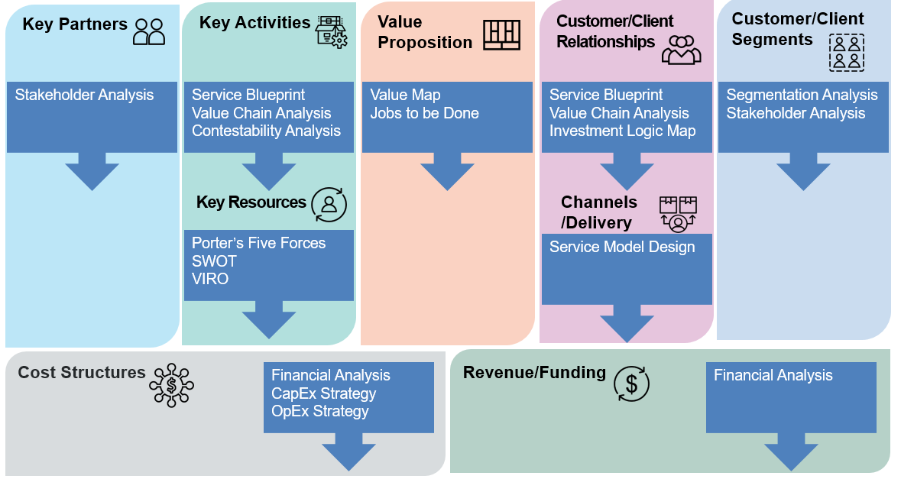
Strategy Model Canvas
Osterwalder, A. et al., (2010), Business Model Generation, Wiley, Hoboken, NJ

Slide 9
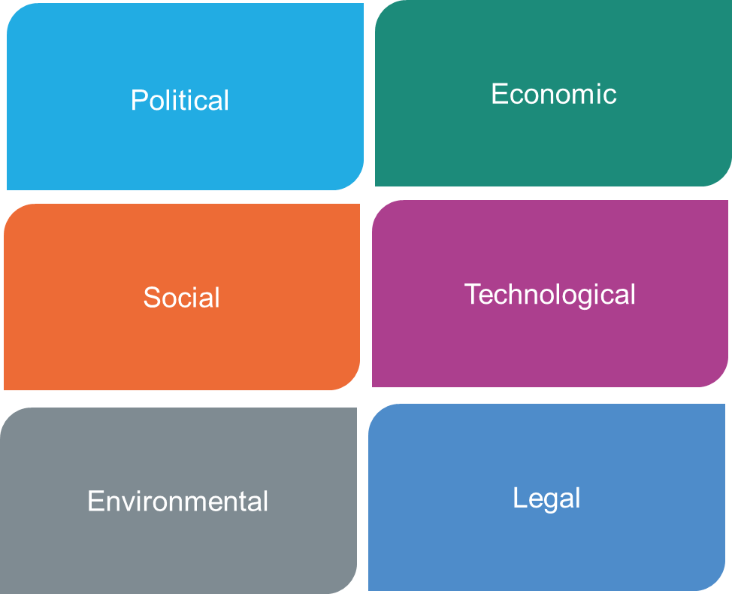
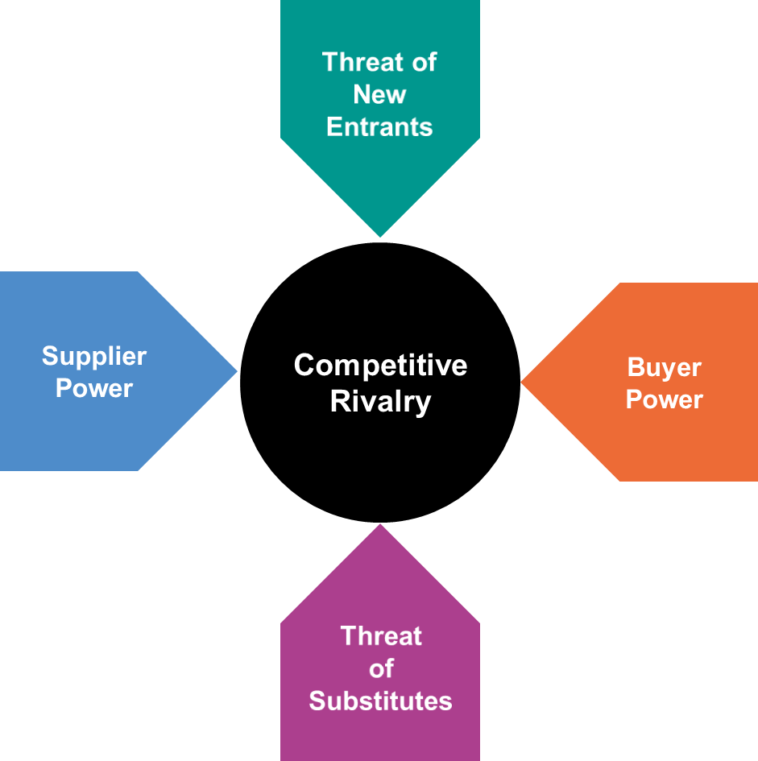

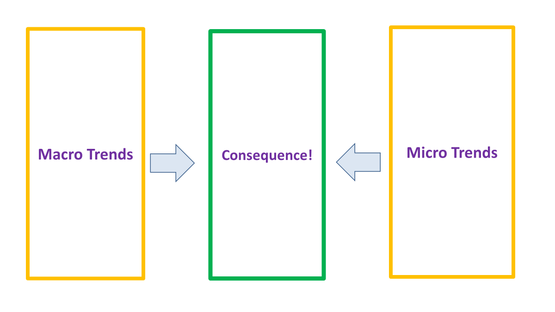
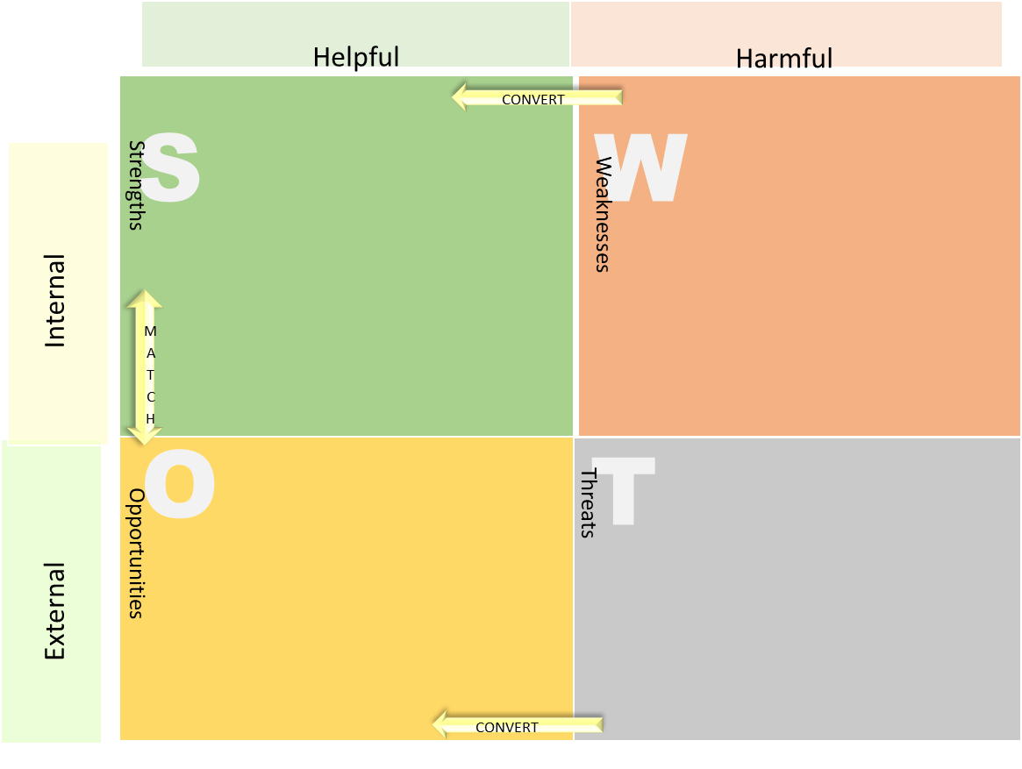
PESTEL, 5 Forces, SWOT, Consequences? Who Cares? Why?

Slide 10
Ways to Create and Communicate Value

